Slide 1
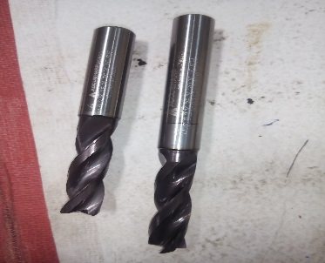
P15
TPM CIRCLE NO :- 01
ACTIVITY
KK
QM
PM
JH
SHE
OT
DM
E&T
KAIZEN IDEA SHEET
TPM CIRCLE NAME: Achiever
LOSS NO. / STEP
DEPT :- MACHINE SHOP
RESULT AREA
P
Q
A
B
C
D
S
M
CELL:- A247
CELL NAME:- CBS
MACHINE / STAGE :- SPM A1
OPERATION :- DRILL/TAP
KAIZEN THEME:- To ELIMINATE DRILL DEPTH OVERSIZE PROBLEM IN CBS FOR9.1
IDEA :- To change tool design
PROBLEM PRESENT STATUS :-Dia 9.1 hole depth 10.0+0.2mm observe 12.00 after tool change.
COUNTERMEASURE - In new Design Total length tolerance added+-0.1mm for overall length.
BENCHMARK
80 nos
TARGET
0
KAIZEN START
10.10.2016
Total tool length tolerance was +-1.0 mm mention in drwg
TDC
15.10.2016
KAIZEN FINISH
15.10.2016
Total tool length Tolerance revised and maintain in 0.1mm
TEAM MEMBERS :-Santosh Wakchaure,
Dyp,navnath,anil
BENEFITS :-
1) Hole shift defect eliminate 2) m/a time loss reduced
Before
After
KAIZEN SUSTENANCE
WHY - WHY ANALYSIS :-
Why1 :- why depth oversize
Why2 :- drill length oversize
Why3 :- in drag no tolerance
Why4 :- Tool design weak
RESULT :-
Dia 9.1 drill depth oversize problem after
tool change eliminated.
WHAT TO DO:- Check point added in Sustenance audit check sheet.
HOW TO DO:- Check visually.
FREQUENCY :- Daily.
SCOPE & PLAN FOR HORIZONTAL DEPLOYMENT
Sr No | CELL | TDC | RESP. | STATUS
1 | Cbs a1/b1/new spm | 30/12/16 | Plant me
2
ROOT CAUSE : tool design weak
REGISTRATION NO. & DATE : 20.09.2016
REGISTERED BY :- santosh wakchaure
MANAGER’S SIGN :- Dy pawar

